Slide 1




DEMOGRAPHY
Version 1.0

Slide 2
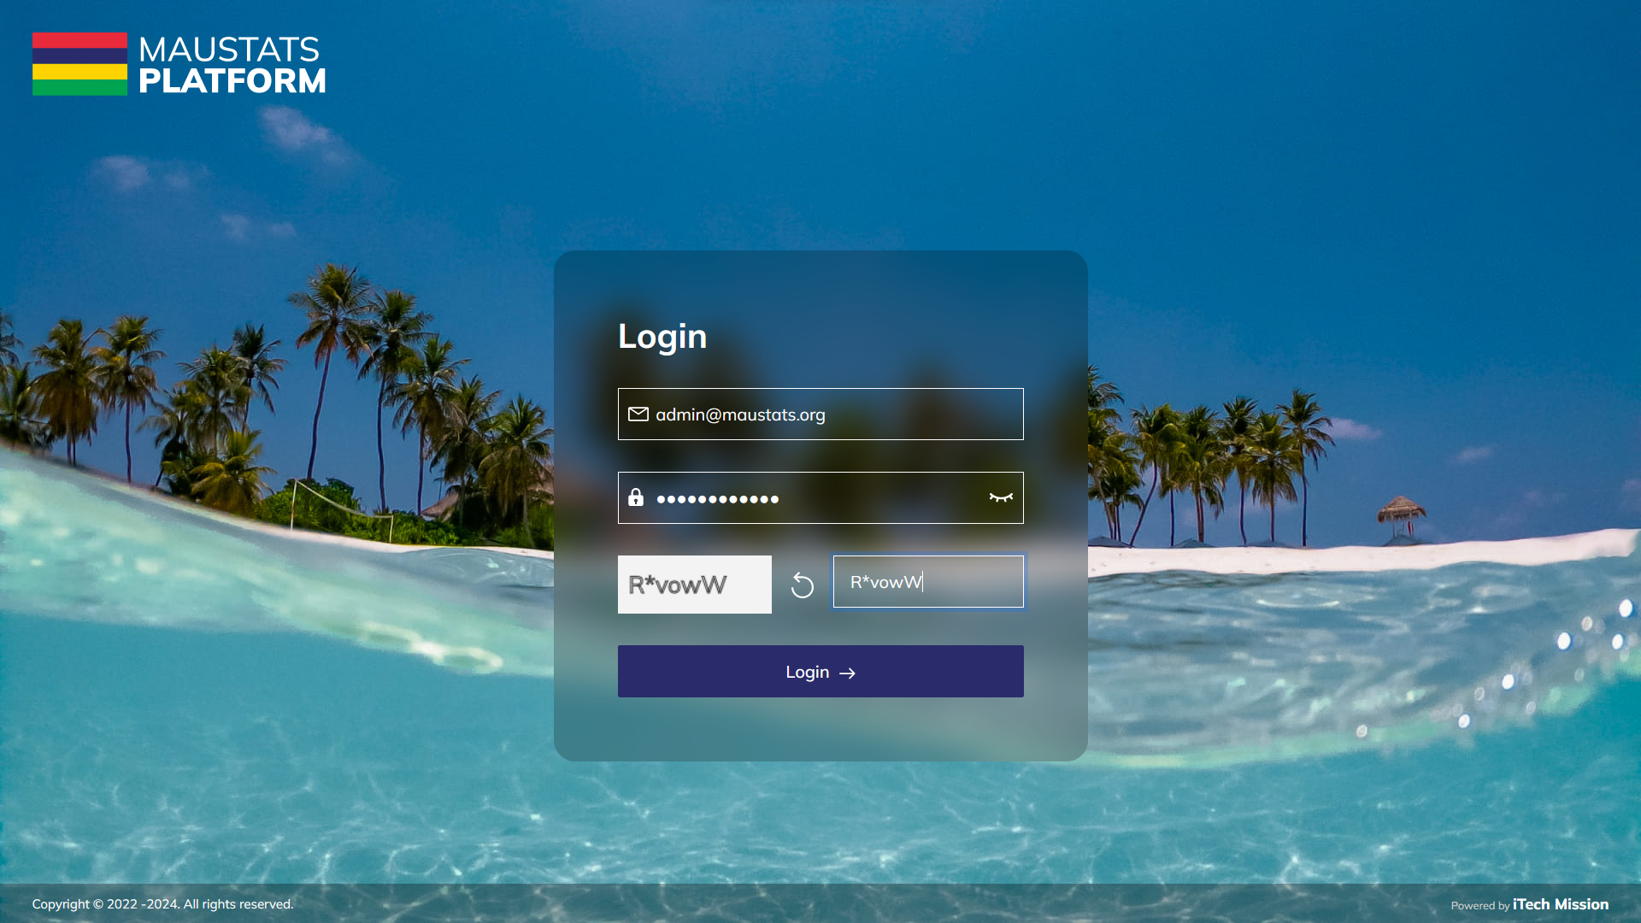
LOGIN
Login using valid credentials to access the Data Management System modules.

Slide 3
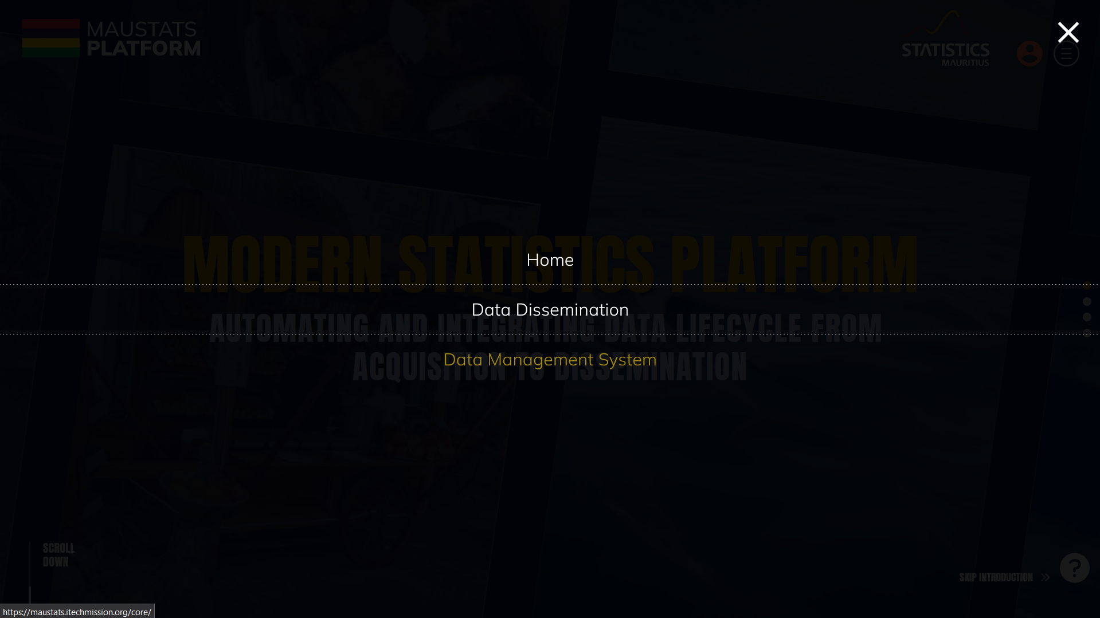
DEMOGRAPHY
To access Demography, click on burger menu and select Data Management System

Slide 4

DEMOGRAPHY
Live Birth
Still Birth
Marriage
Death

Slide 5
1
LIVE
BIRTH

Slide 6
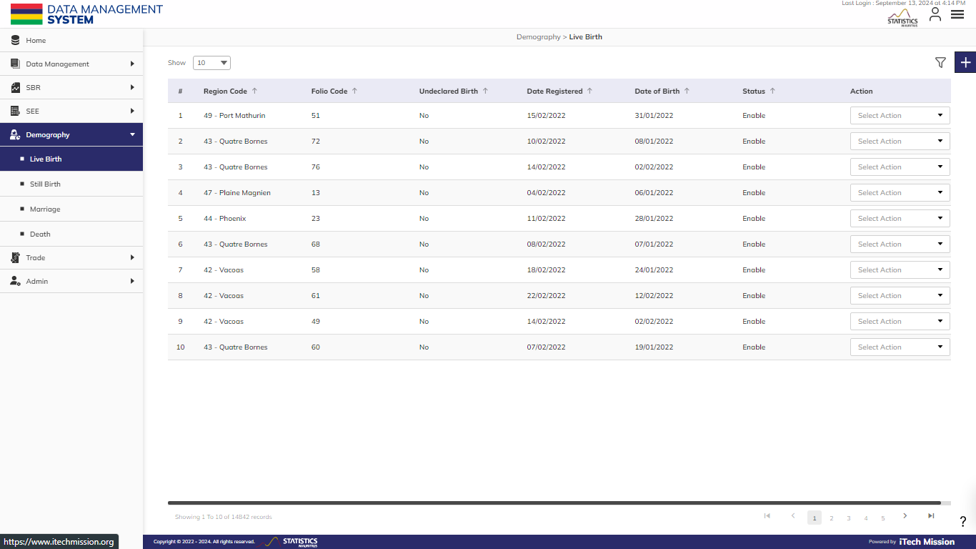
LIVE BIRTH
To manage Live Birth data, Select Demography – Live Birth.

Slide 7
LIVE BIRTH
Click on the Plus button to add a new record.

Slide 8
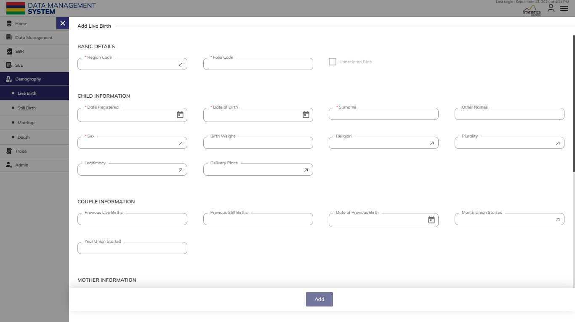
LIVE BIRTH
Enter Basic Details, Child Information, Couple Information, Mother Information, Father Information and Address Information.

Slide 9

LIVE BIRTH
After adding the mandatory fields, the "Add" button will be available to click and save the record.

Slide 10
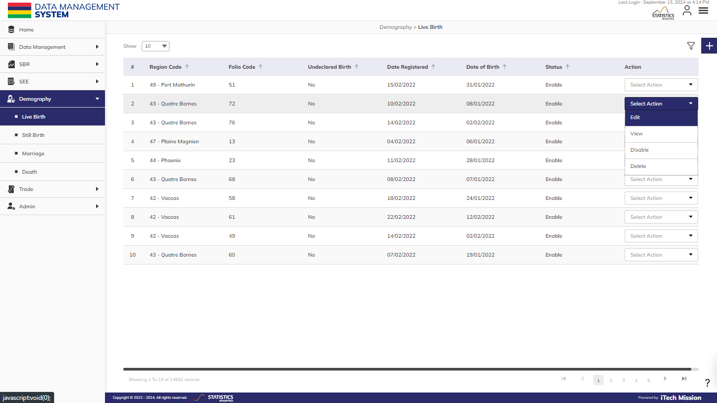
LIVE BIRTH
Click on the action dropdown to Edit, View, Enable/Disable, and Delete the selected record.

Slide 11
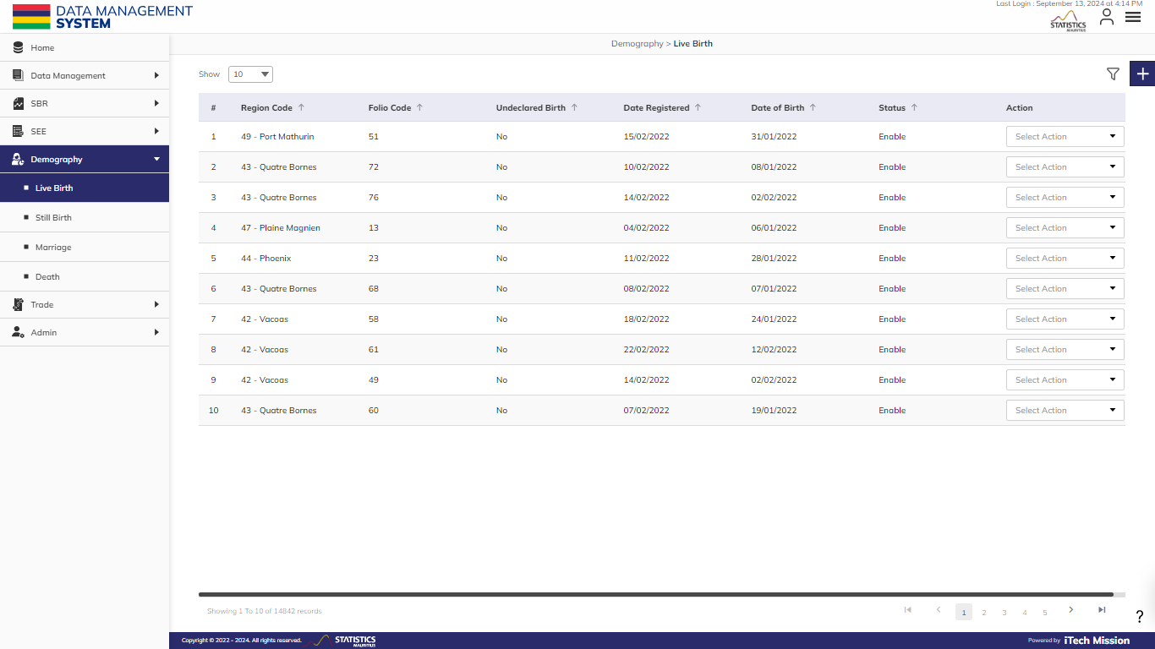
LIVE BIRTH
Click on Filter icon to apply filters and view filtered data.

Slide 12
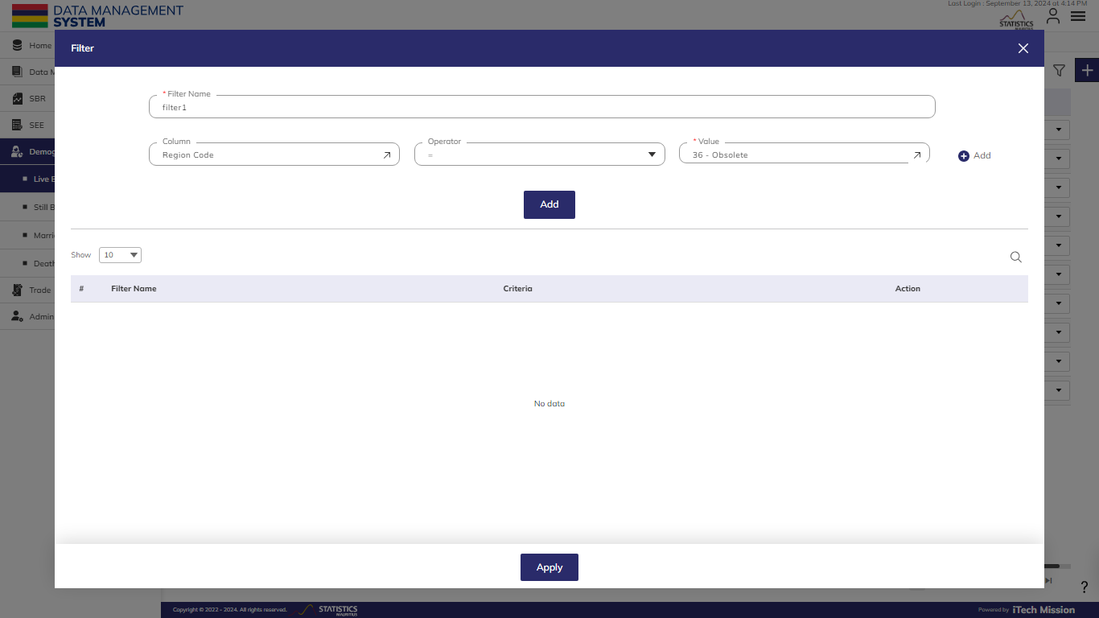
LIVE BIRTH
Enter the Filter Details and Click on Add to save the filter. Click on Apply to view the filtered data.

Slide 13
2
STILL
BIRTH

Slide 14
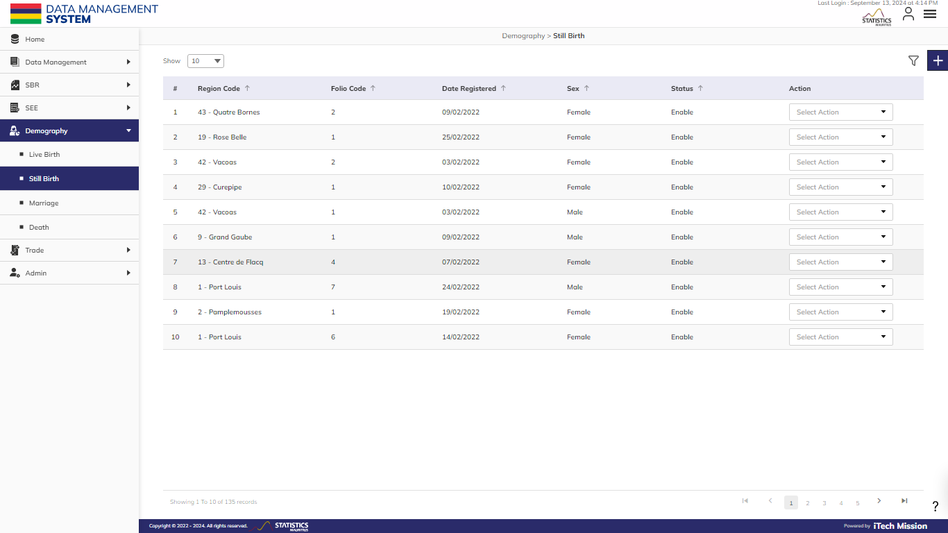
STILL BIRTH
To manage Still Birth data. Select Demography – Still Birth.

Slide 15
STILL BIRTH
Click on the Plus button to add a new record

Slide 16
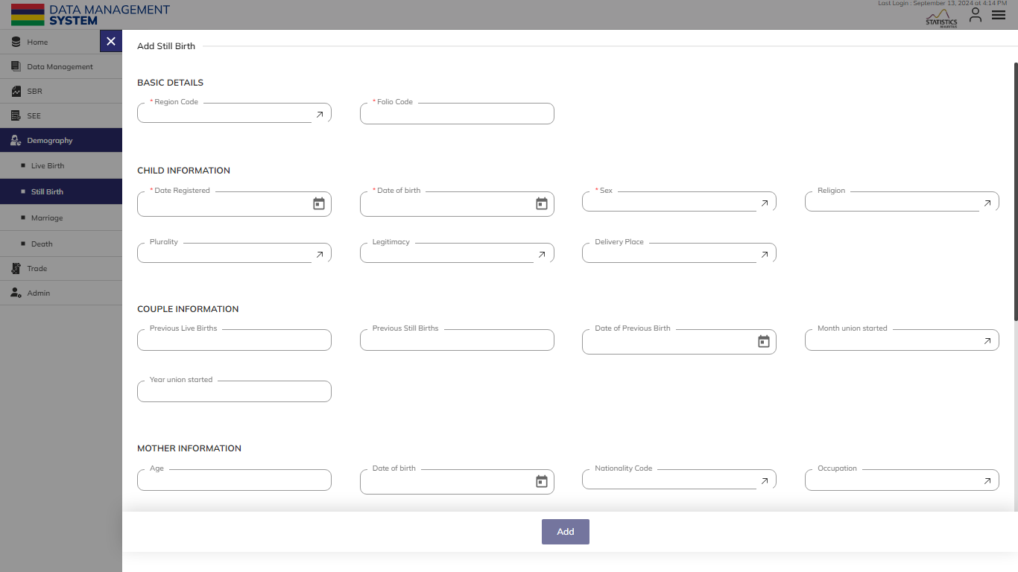
STILL BIRTH
Enter Basic Details, Child Information, Couple Information, Mother Information, Father Information and Address Information.

Slide 17
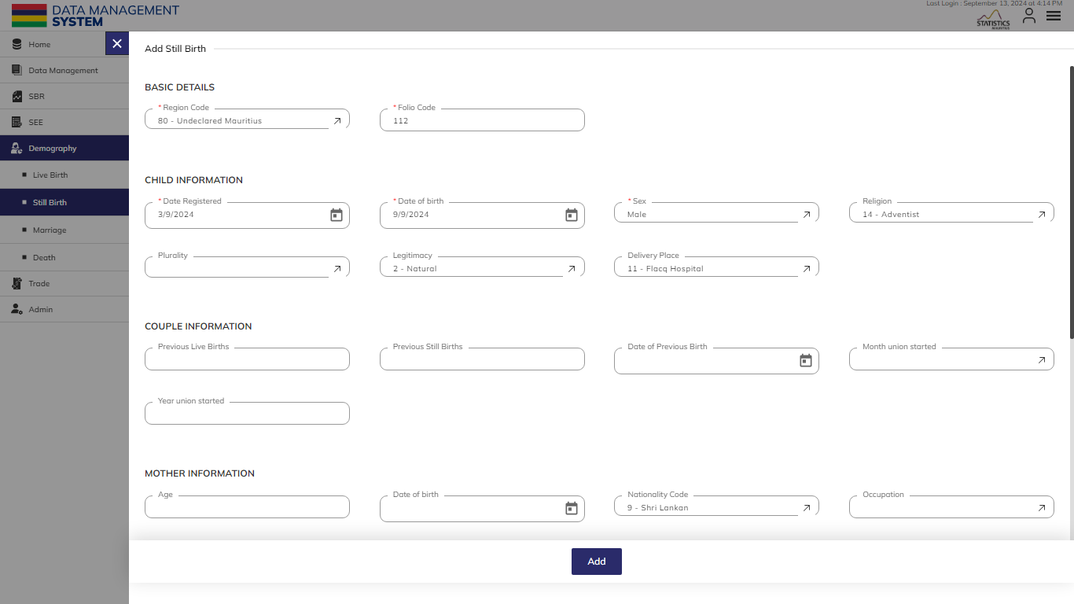
STILL BIRTH
After adding the mandatory fields, the "Add" button will be available to click and save the record.

Slide 18
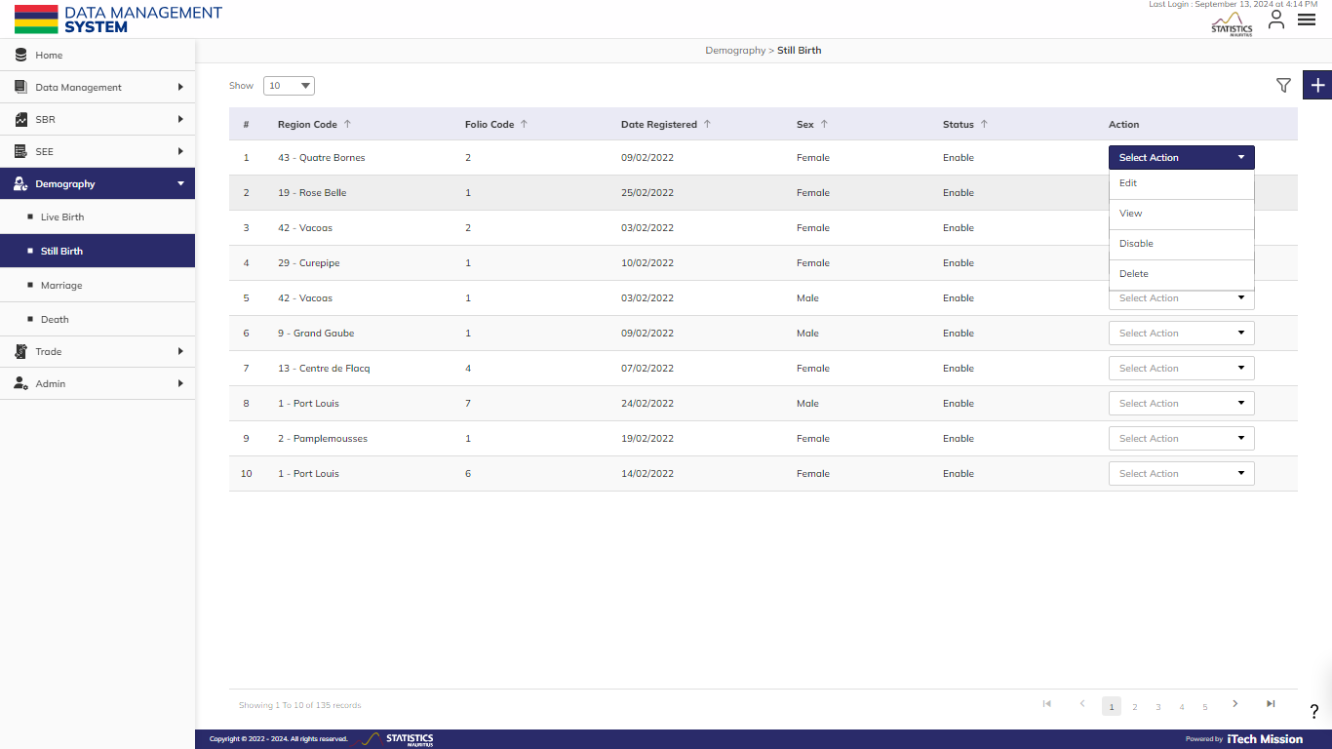
STILL BIRTH
Click on the action dropdown to Edit, View, Disable/Enable, and Delete the selected record.

Slide 19
STILL BIRTH
Click on Filter icon to apply filters and view filtered data.

Slide 20
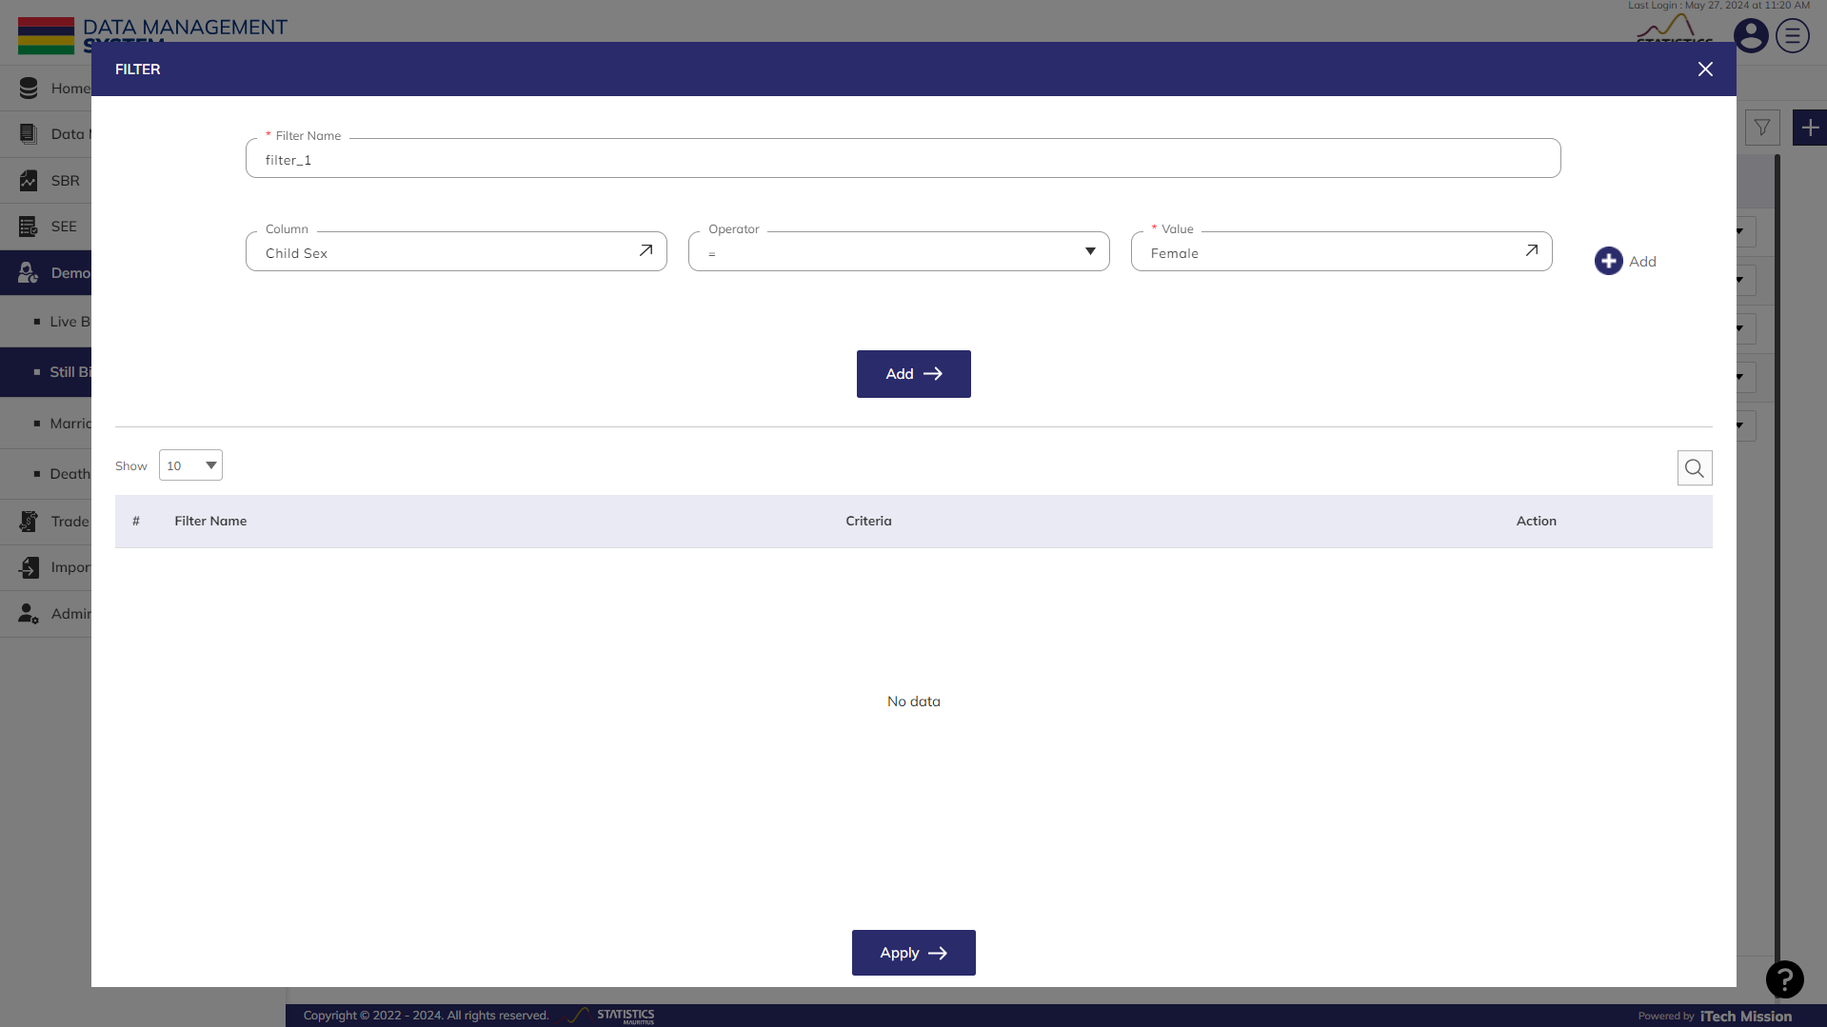
STILL BIRTH
Enter the Filter Details and Click on Add to save the filter. Click on Apply to view the filtered data.

Slide 21
3
MARRIAGE

Slide 22
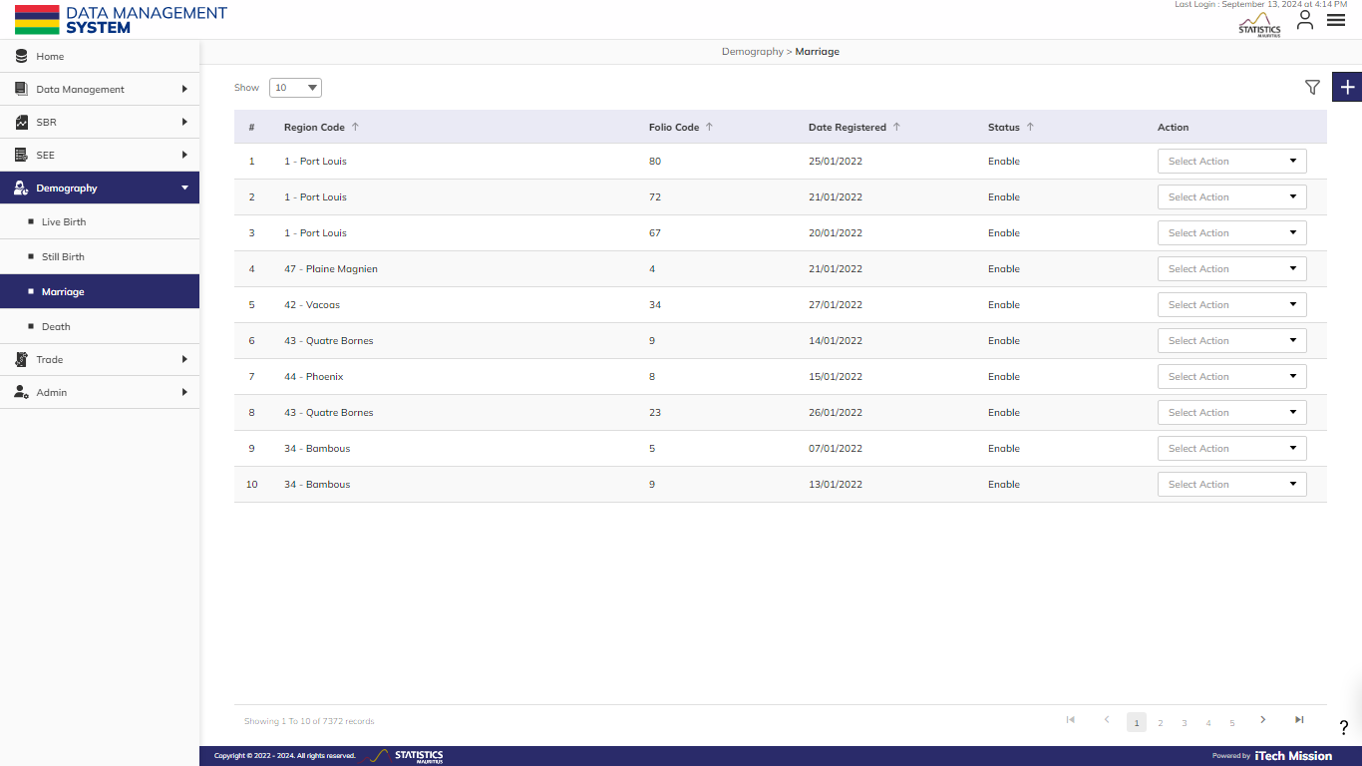
MARRIAGE
To manage Marriage data. Select Demography – Marriage.

Slide 23
MARRIAGE
View existing marriage data in tabular view. Click on Plus button to add a new record.

Slide 24
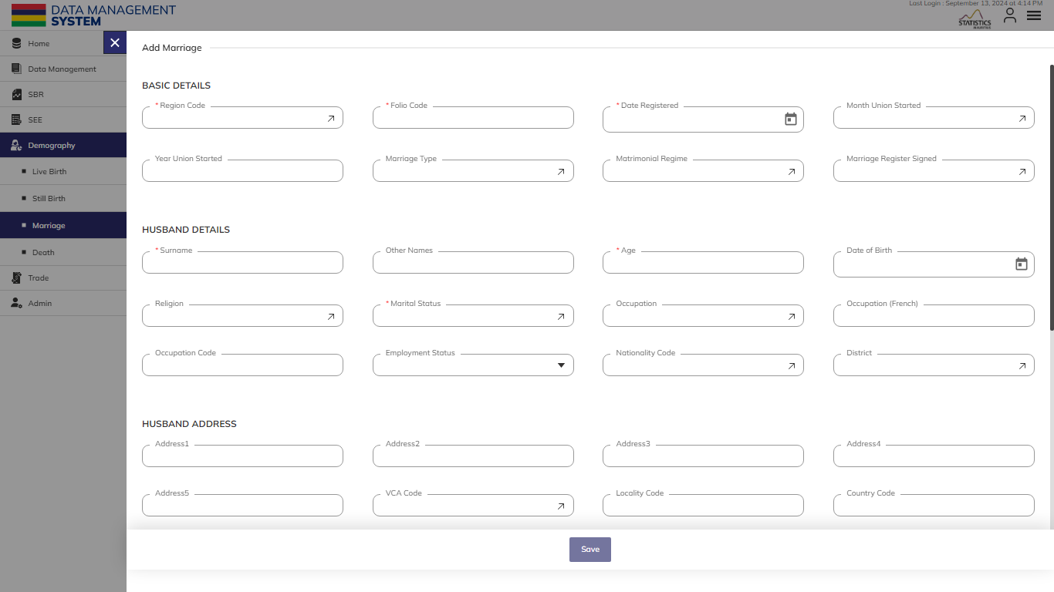
MARRIAGE
Enter mandatory Basic Details, Husband Details, Husband Address, Wife Details and Wife Address.

Slide 25
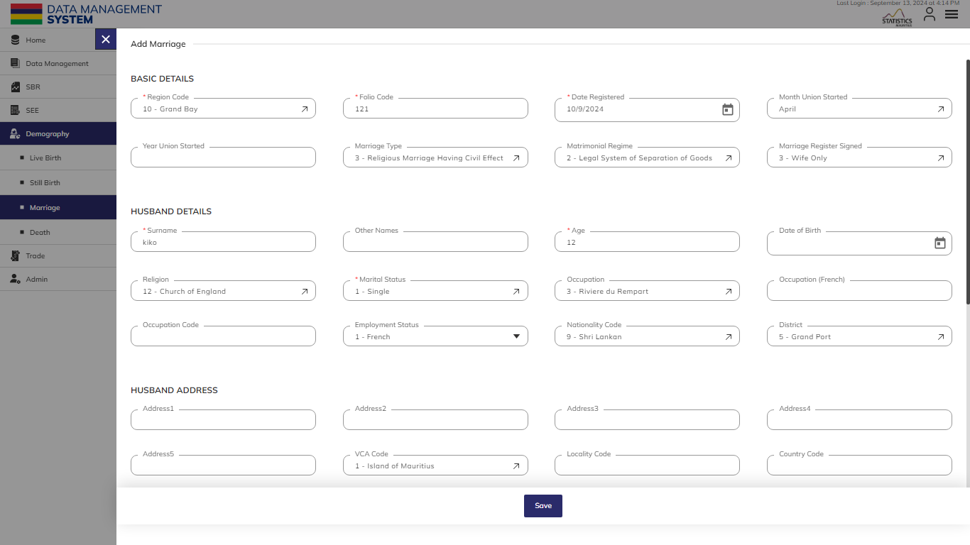
MARRIAGE
After adding the mandatory fields, the “Save" button will be available to click and save the record.

Slide 26
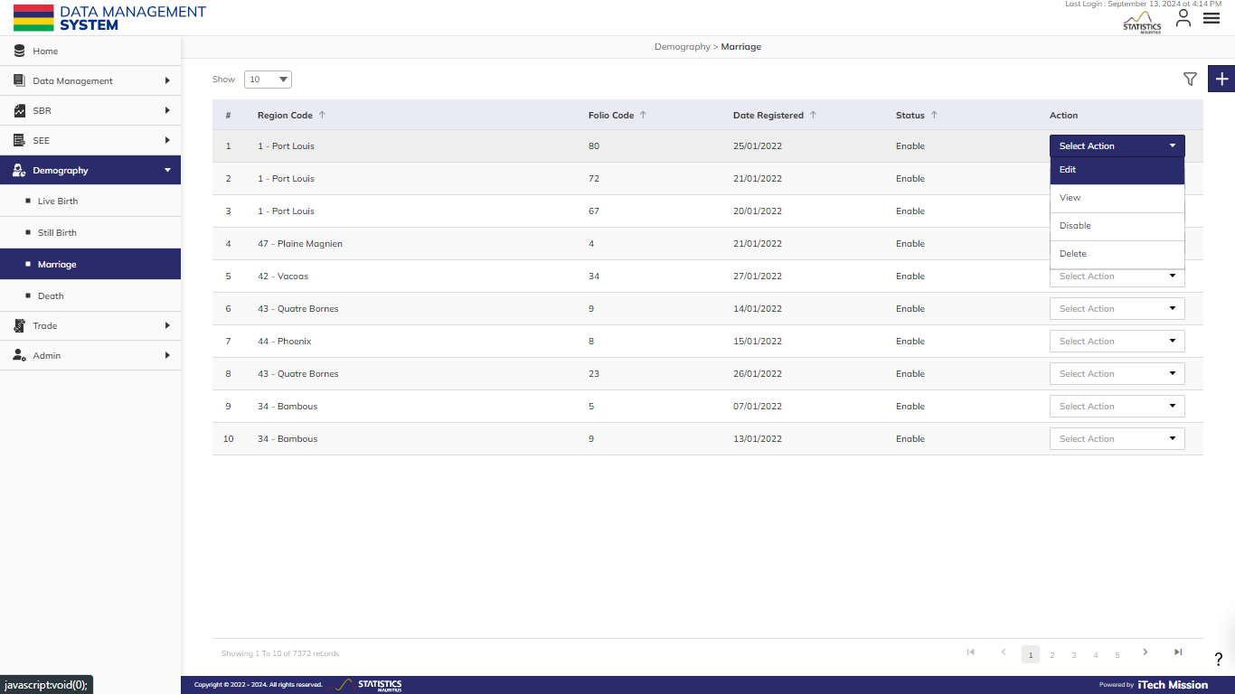
MARRIAGE
Click on the action dropdown to Edit, Enable/Disable and Delete the selected record.

Slide 27

MARRIAGE
Click on Filter icon to apply filters and view filtered data.

Slide 28
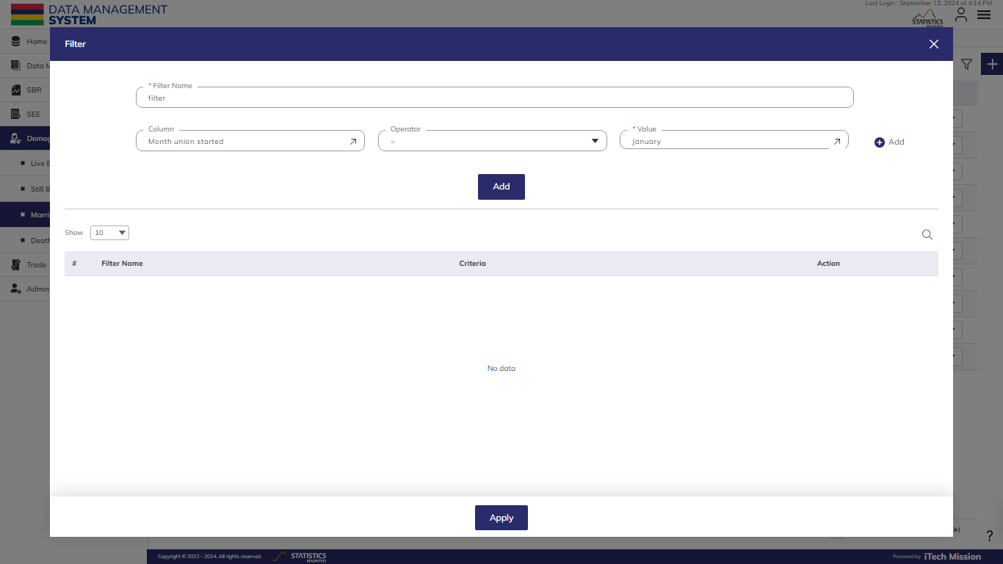
MARRIAGE
Enter the Filter Details and Click on Add to save the filter. Click on Apply to view the filtered data.

Slide 29
4
DEATH

Slide 30
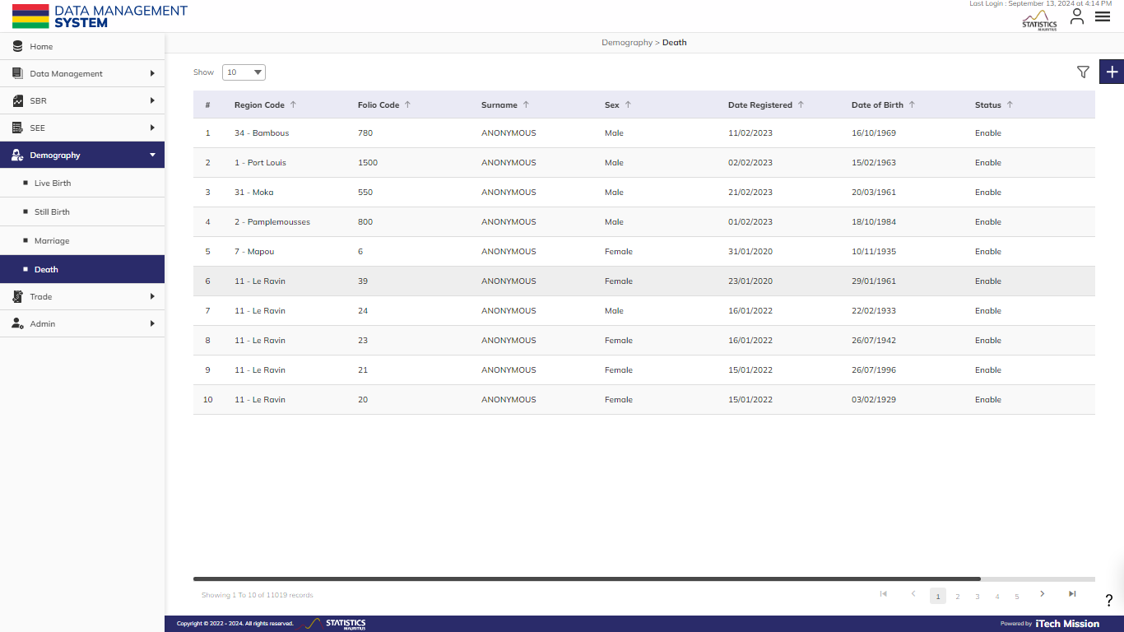
DEATH
To manage Death data. Select Demography – Death.
.

Slide 31
DEATH
View existing death data in tabular view. Click on Plus button to add a new record.

Slide 32
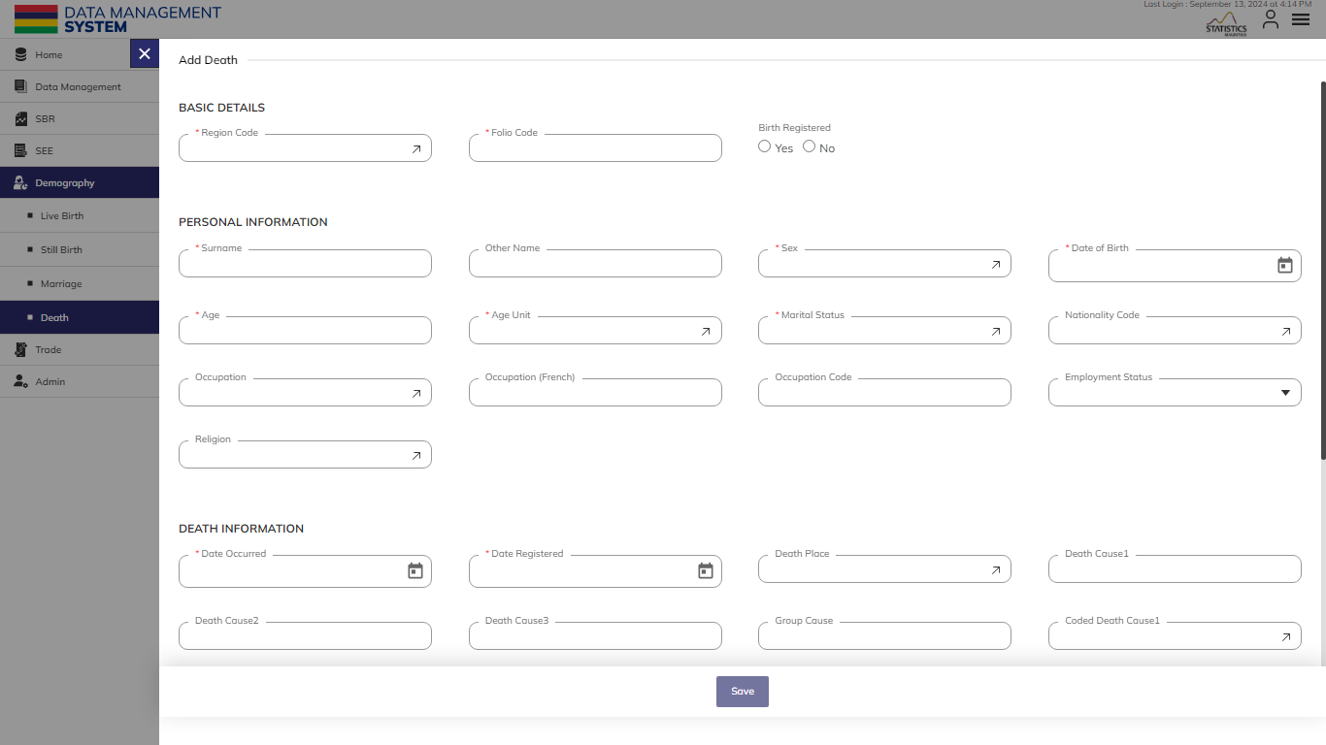
DEATH
Enter mandatory Basic Details, Personal Information, Death Information and Address Information.

Slide 33

DEATH
After adding the mandatory fields, the “Save" button will be available to click and save the record.

Slide 34
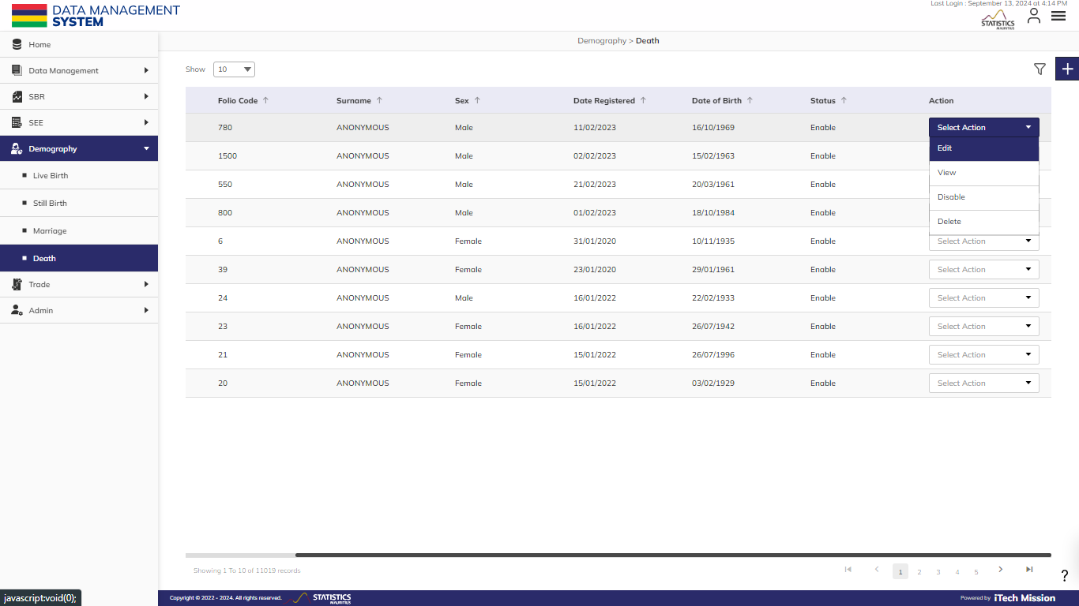
DEATH
Click on the action dropdown to Edit, Enable/Disable and Delete the selected record.

Slide 35
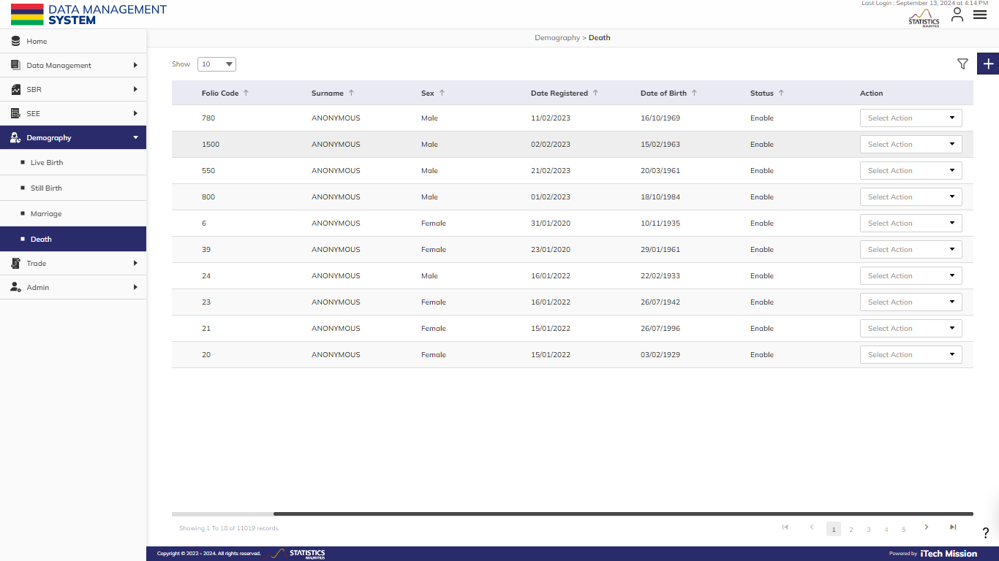
DEATH
Click on Filter icon to apply filters and view filtered data.

Slide 36
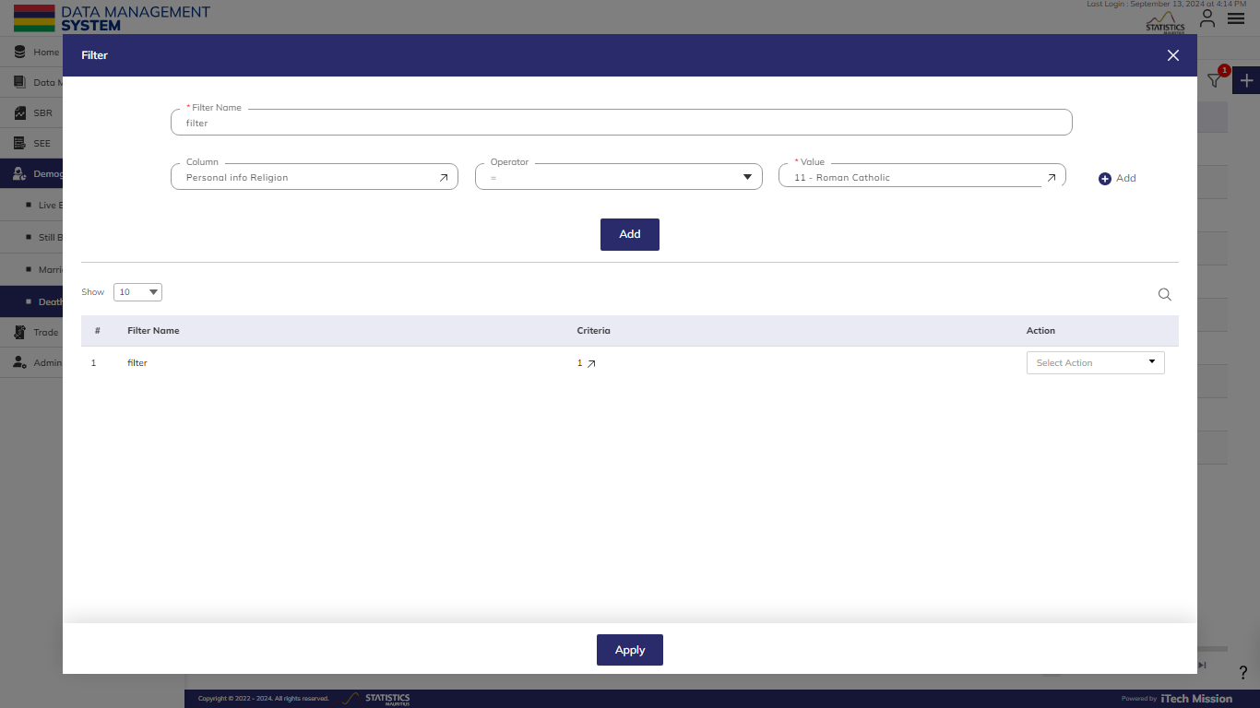
DEATH
Enter the Filter Details and Click on Add to save the filter. Click on Apply to view the filtered data.

Slide 37


